Slide 1
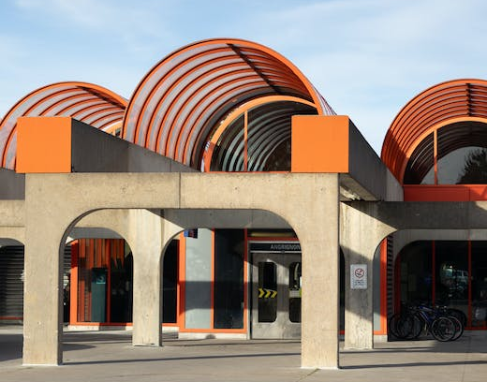
ESOFT Metro Campus.
sathusan@1secmail.com

Slide 2
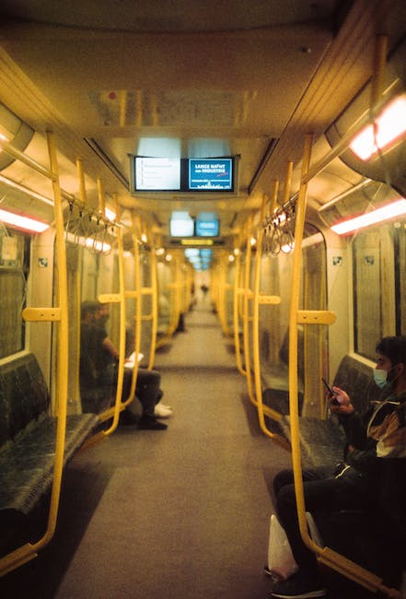
Content
ESOFT Metro Campus
Academic and Professional Qualifications
Nationwide Branches
Dr Dayan Rajapakse

Slide 3
'ESOFT Metro Campus'
'ESOFT Metro Campus previously known as ESOFT Computer Studies is a private sector educational institute located in Colombo Sri Lanka

Slide 4

'Academic and Professional Qualifications'
It offers academic and professional qualifications in computing business management engineering hospitality and English

Slide 5

'Nationwide Branches'
Established in the year the company today has branches all over the country and is headed by the esteemed Dr

Slide 6

'Dr Dayan Rajapakse'
Dayan Rajapakse' 'The academic and professional qualifications offered by this college are quite varied and include computing business management engineering hospitality and English

Slide 10

THANK YOU !
2023-10-19

